Slide 1


Learning DevOps through Minecraft
Dr. Robbeloth
12/5/2024
https://github.com/mrobbeloth/Lectures

Slide 2
Background
Problem: I want to have my friends all play Minecraft with me in the lab or in our dorm room (but not the classroom, I know better)
I don’t want to have to recreate everything to get the server running every time. What can I do?

Slide 3
DevOps to the Rescue
What is DevOps?
It’s a philosophy and a set of practices that shorten the systems development life cycle
Provides continuous delivery w/ high software quality
Emphasizes collaboration, automation, and rapid feedback cycles as well
Outcome is better customer satisfaction – here you are the customer and the engineer

Slide 4
What would a DevOps Engineer do in a typical day?
Provision cloud resources
Manage virtual machines and containers
Work on network infrastructure (switches, firewalls, VPNs, load balancers, etc.)
Review logs and dashboards to identify trouble spots or areas needing intensive redesign
Automate building and testing of code (CI)
Automate deployment of software deliverables (CD)\
Problem solve or troubleshoot issues, do root-cause analysis
Stay up-to-date w/ current trends

Slide 5
What tools does a DevOps Engineer use? (a small sample)
Ansible, Puppet, and/or Chef to manage infrastructure
Shells like Bash or Powershell, write scripts for those shell environments
Use interpreted languages like Python to automate tasks (could also be used compiled languages)
Use VMWare ESXi/Proxmox/Hyper-V to manage virtual machines
Use Docker/Kubernets to manage containers
Manage code, script, deliverables, etc., using a Git repository system (in-house or 3rd party GitLab/GitHub)
CircleCI/TravisCI for cloud based automations
Terraform/CloudFormation/Azure Resource Manager for IaC
Prometheus/Grafana/ELK stack for monitoring/dashboards/visualizations
Slack/Teams/Jira/Discord to communicate and share
Notes:
Iac Infrastructure a
Security: Nessus: A vulnerability scanner. OpenSCAP: A compliance checker. Vault: A tool for managing secrets and sensitive data.s Code

Slide 6
Goals
Learn about DevOps through the lens of Minecraft
Learn about critical tools used in DevOps like Virtual Machines and Containers
Learn about a specific container technology called Docker
Use Docker to deploy a MineCraft Server
Play Minecraft

Slide 7
What are Virtual Machines (VMs)?
VMs are software derived computers that emulate a host computer’s functionality
Hosted inside a hypervisor (type one is run on dedicated servers; type two w/ host os support)
I use VMWare Pro on Windows/Linux Host
I recommend using Ubuntu Server 24.04 and the Docker snap package (lightweight, but versatile)
Lots of other possibilities

Slide 8
Instructions for VM Setup
Go to https://ubuntu.com/download/server, download the server image
File New→Virtual Machine in VMWare Pro
If you want it simple:
Choose Typical and point to the installer ISO file
Give it a name and Location, 20.0 GB disk file (store as a single file to maximize performance)
If you want to configure it w/ more RAM and make it easier to allow others to connect, use Custom and specify accordingly

Slide 9
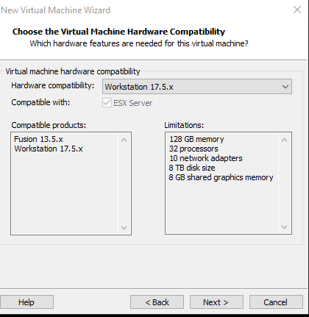
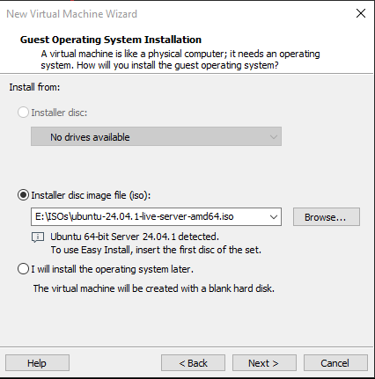
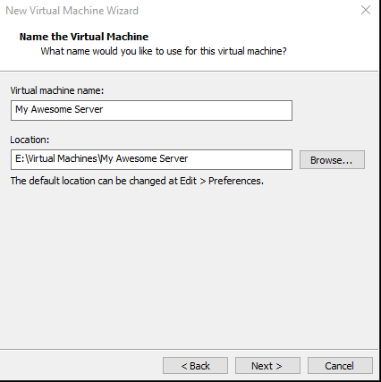
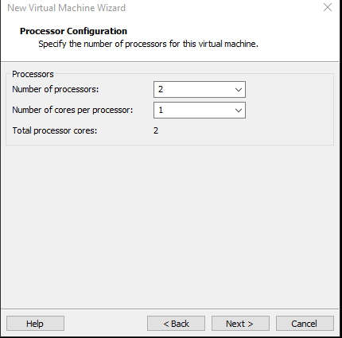
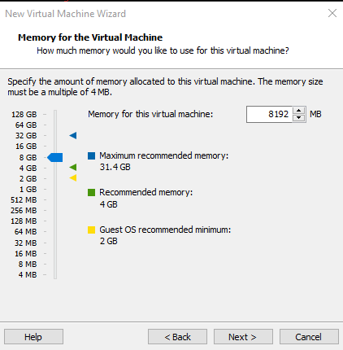
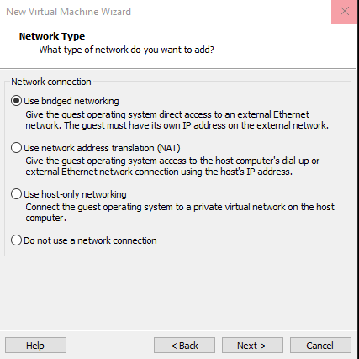

Slide 10
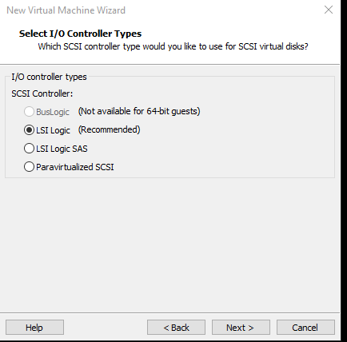
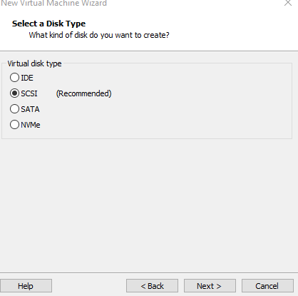
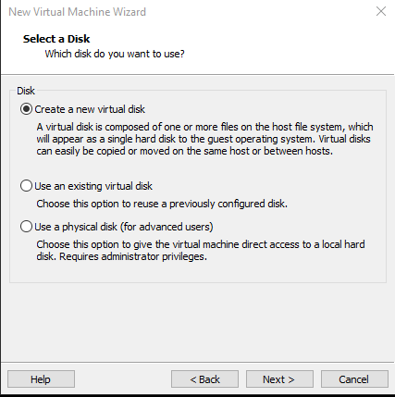
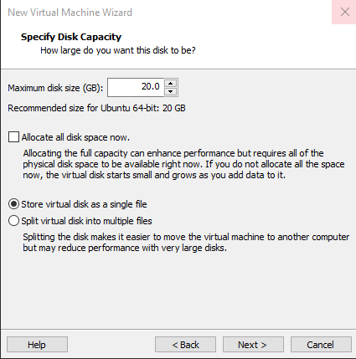
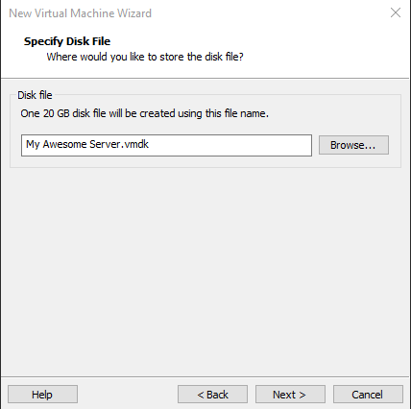
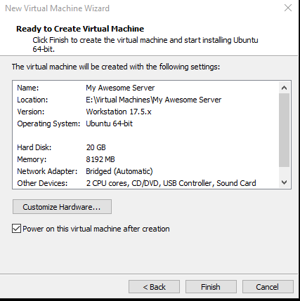

Slide 11
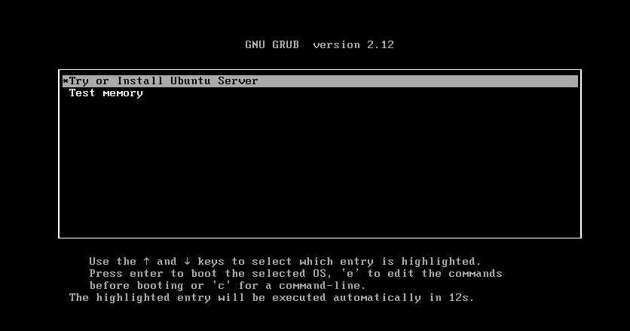
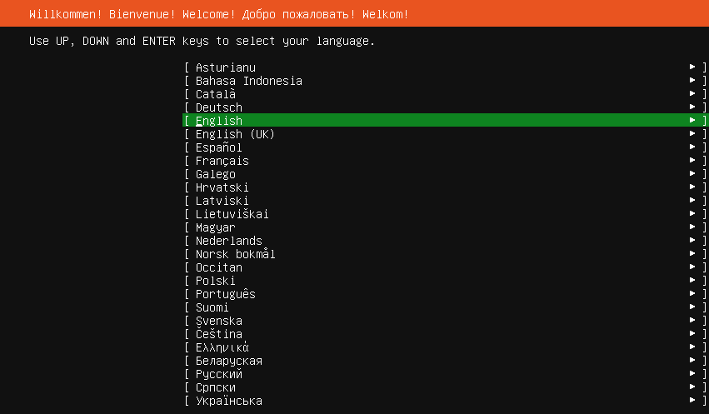

Slide 12
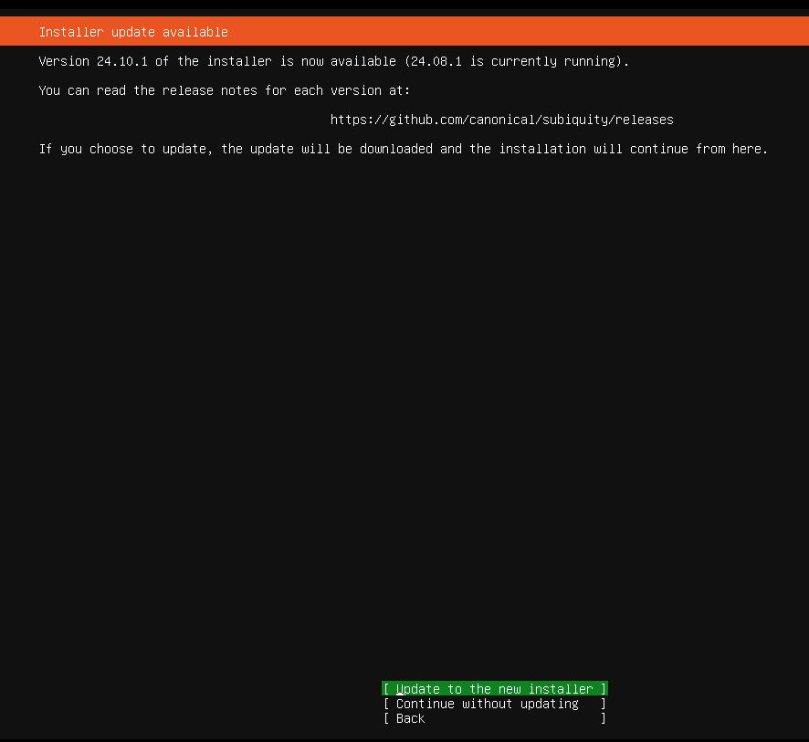

Slide 14
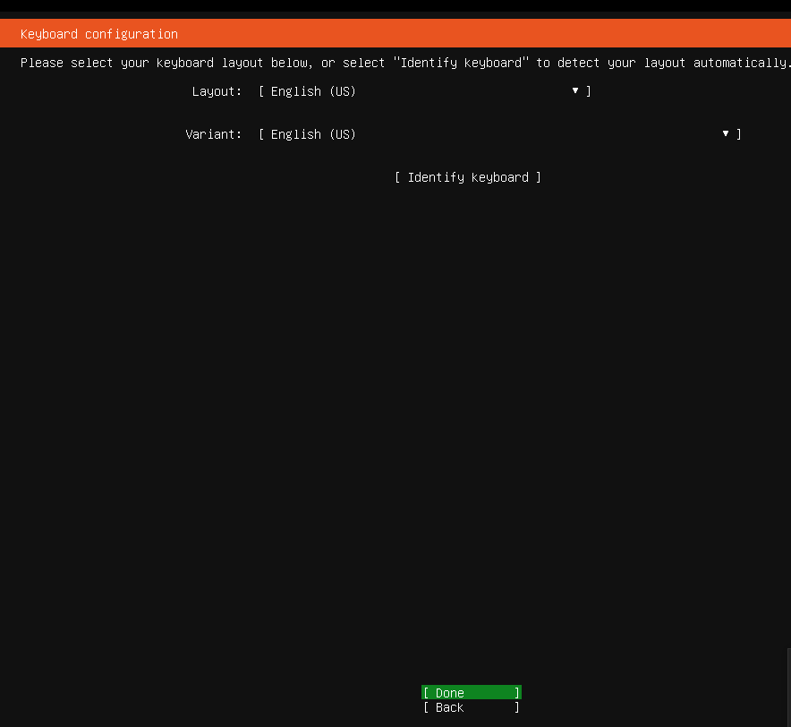

Slide 15
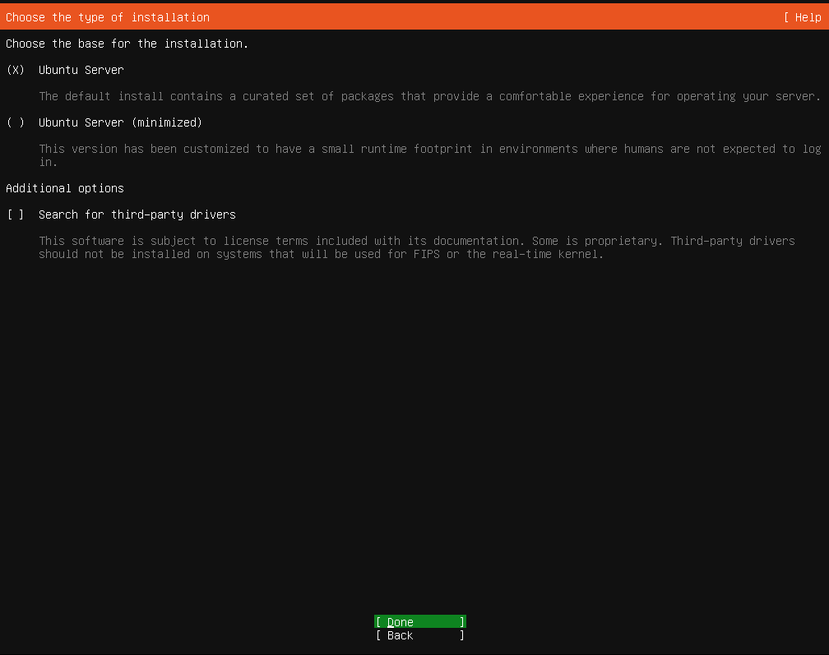

Slide 16
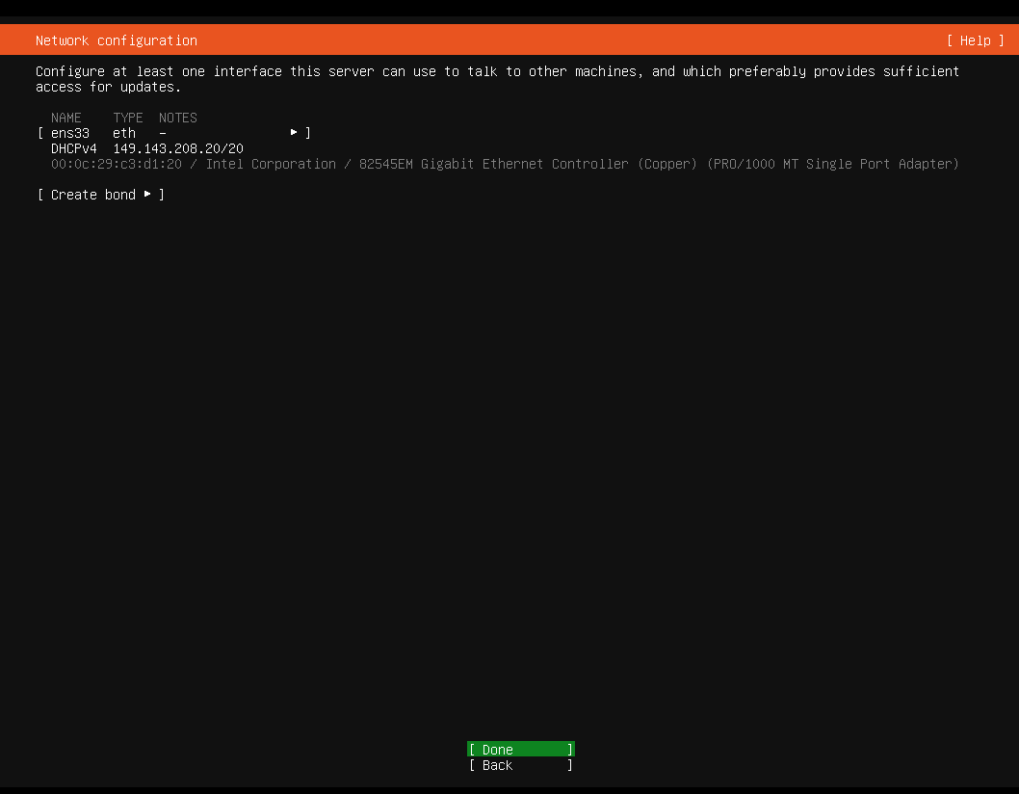
Notes:
Confirm network settings, should look like bridged network is being used and not NAT (192,168.100.,something or other private ip address range depending on class)

Slide 17
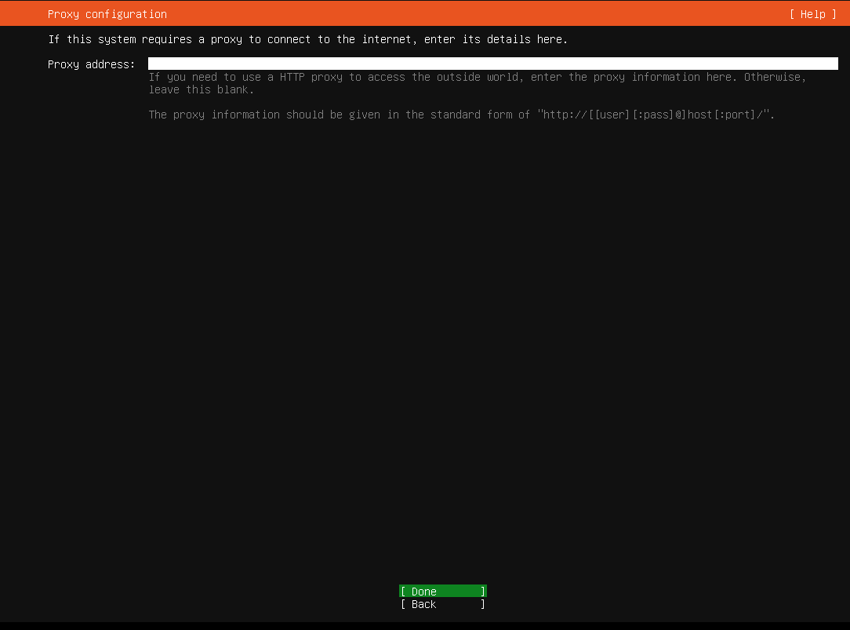
Notes:
Confirm network settings, should look like bridged network is being used and not NAT (192,168.100.,something or other private ip address range depending on class)

Slide 18
Notes:
Probably leave blank unless your campus was an unusual setup

Slide 19
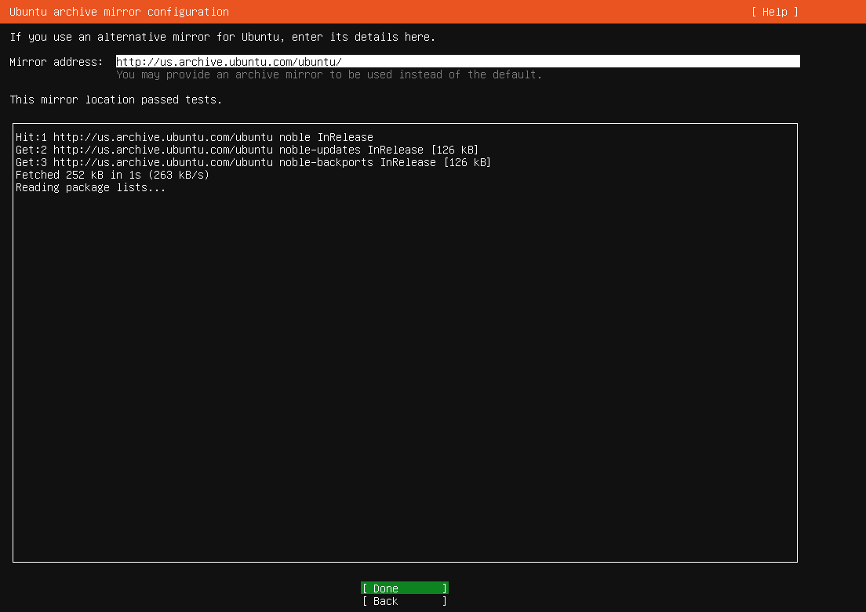
Notes:
Probably leave blank unless your campus was an unusual setup

Slide 20
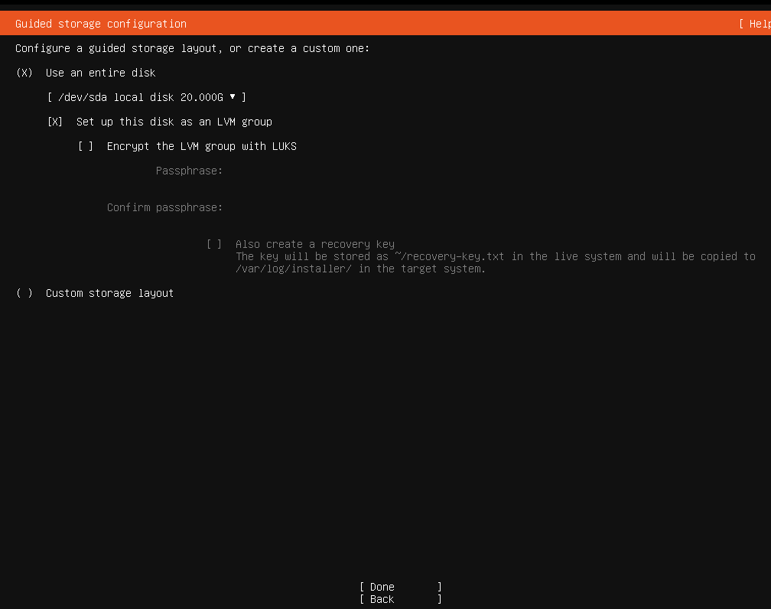
Notes:
Leave defaults, encryption will slow down performance

Slide 21
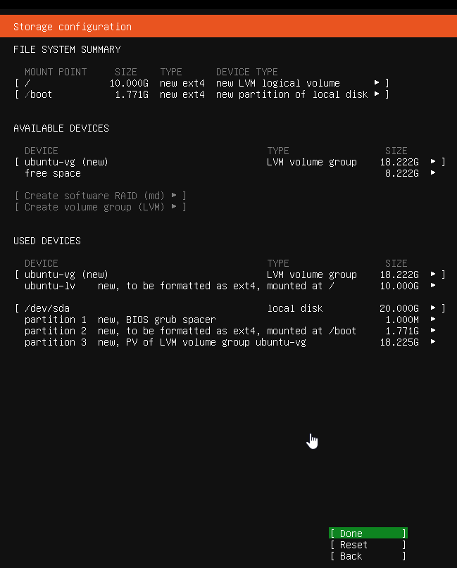
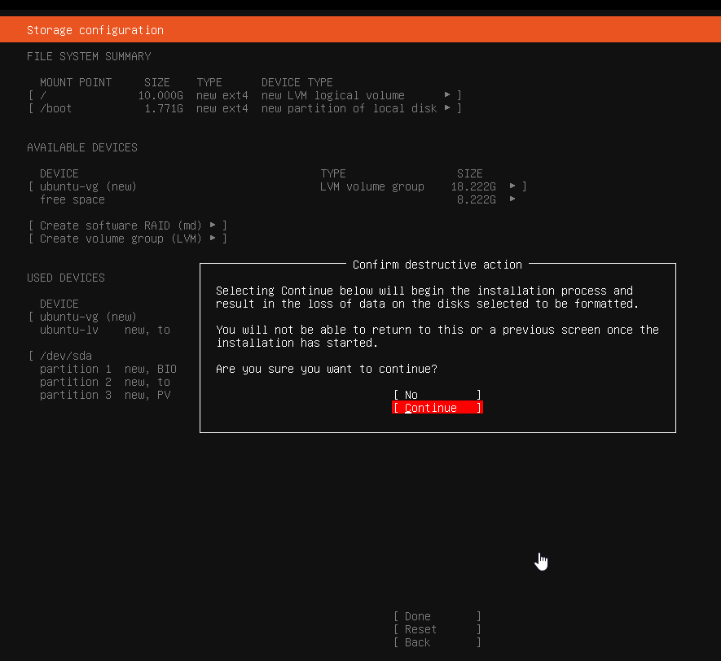
Notes:
Leave defaults, encryption will slow down performance

Slide 22
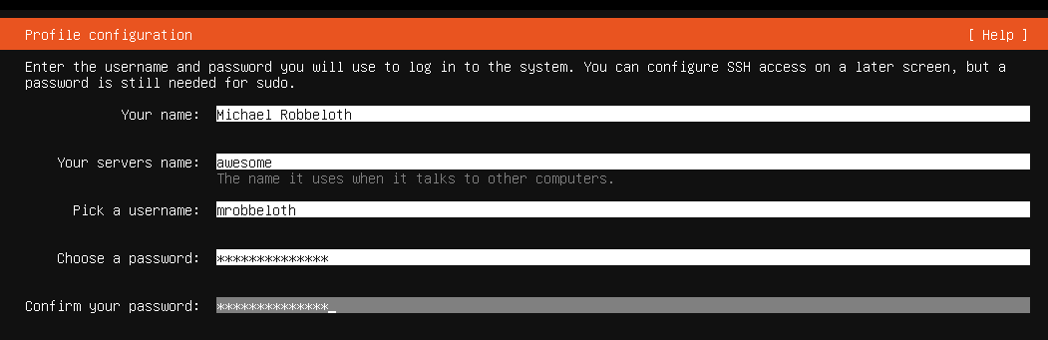
Notes:
Leave defaults, encryption will slow down performance

Slide 23
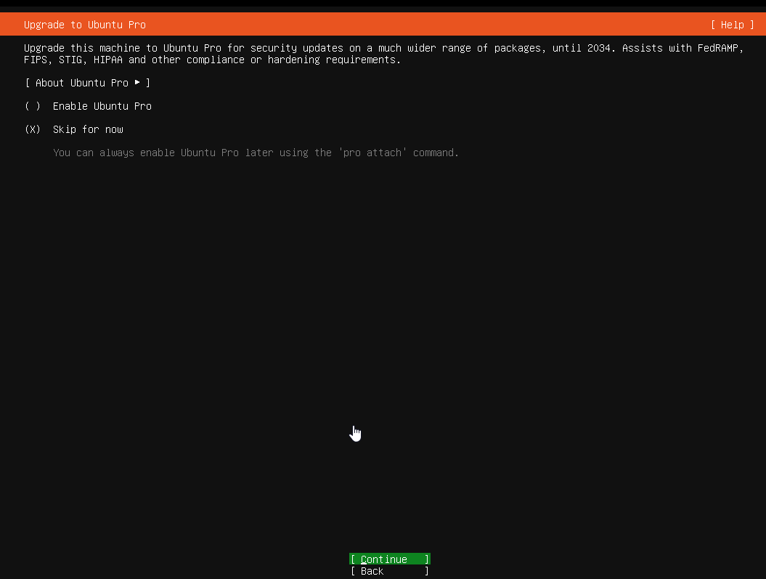
Notes:
Leave defaults, encryption will slow down performance

Slide 24
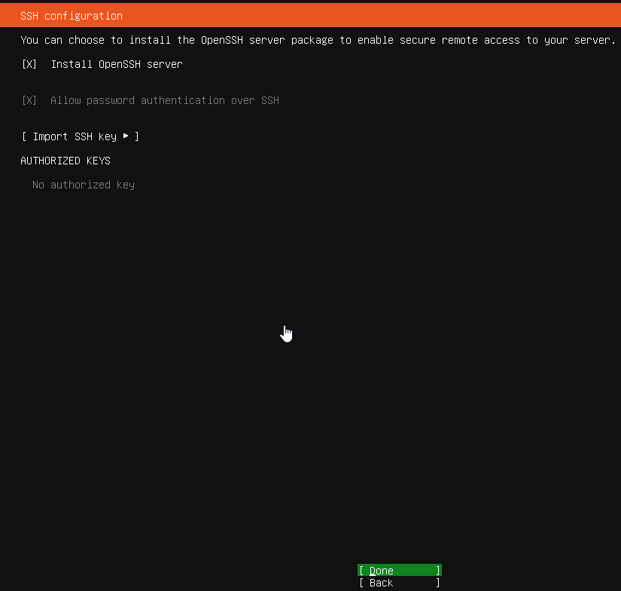
Notes:
Leave defaults, encryption will slow down performance

Slide 25
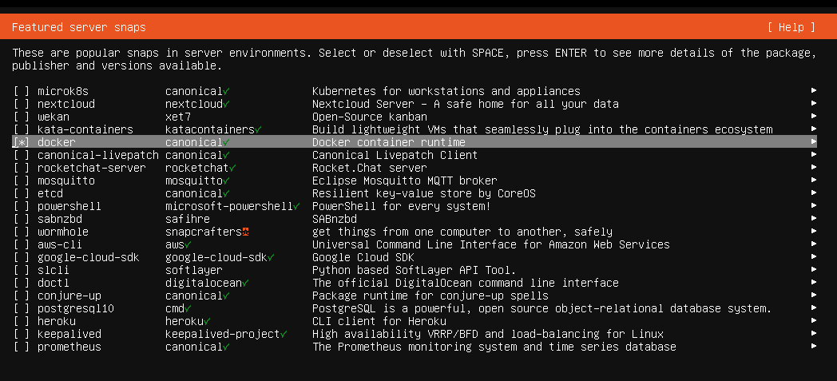
First Method: Not recommended by Docker folks, but I do it sometimes since it is easy
Notes:
Actually, don’t do this anymore. We need to follow the official Docker guide.

Slide 26
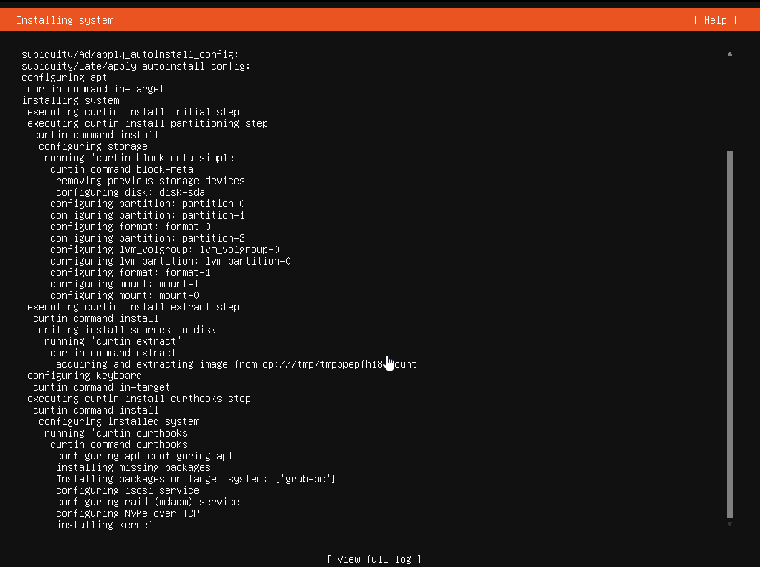
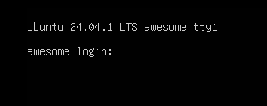
Notes:
Click on reboot now when it appears

Slide 27
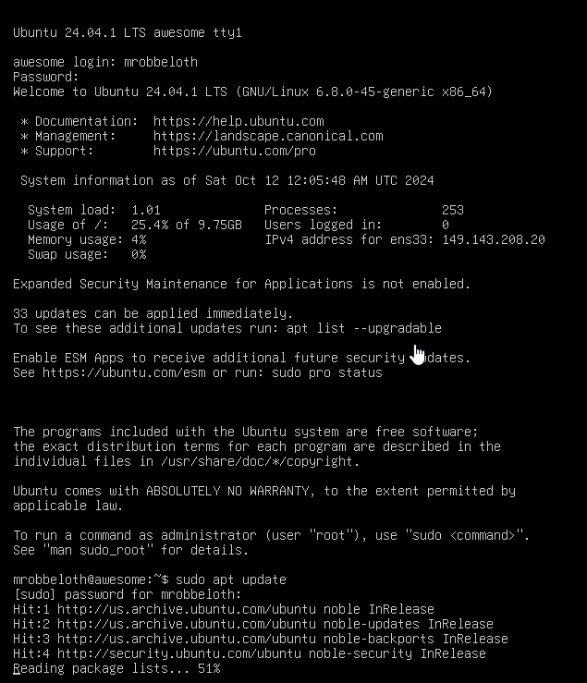
Notes:
Sudo apt update and upgrade

Slide 28
Alternative: Official guide to install Docker
Go to https://docs.docker.com/engine/install/ubuntu/
Use the apt method after removing any docker snap packages
Docker community says to follow their guide, don’t follow the Ubuntu recommendation
Add their repo, install packages from their repo

Slide 29
What are containers?

Slide 30
So, what are containers? 1/2
Docker defines it as, “A container is a standard unit of software that packages up code and all its dependencies so the application runs quickly and reliably from one computing ...”
OS/App virtualization utilizing network resources
Runs in an isolated (sandboxed) user space environment (e.g., leaves host environment undistributed during/after execution)
Containers share common OS
Lighter than virtual machines (e.g., use fewer resources than VMs), we can run multiple containers on one server/VM
Notes:
This will allow us to deploy are customized Minecraft server environment on whatever hardware we have access in an easier manner than trying to build on dedicated hardware or by moving a virtual machine around and around to different hypervisors.

Slide 31
So, what are containers? 2/2
Docker is a type of containerization technology (also a company)
Runs on Linux, Windows, or Mac
Deploy on-premise w/ dedicated hardware, onto public cloud VMs (AWS/Azure) or in a private cloud (cloud infrastructure for a single company), etc.
On Linux, it utilizes its namespace, cgroup, and virtualization tech (e.g., LXC, libvirt, systemd-nspawn)
Docker CLI and Engine is free. Docker Desktop is a dev focused tool that costs enterprises money to make it easier to develop/test containers
Notes:
Docker is based on the Moby project, written in the Go language.
Has x86-64, ARM, s390x, and ppc64 implementations (no RISC-V)
This will allow us to deploy are customized Minecraft server environment on whatever hardware we have access in an easier manner than trying to build on dedicated hardware or by moving a virtual machine around and around to different hypervisors.
I have also played with LXC and LXD containers. Work fine, but obviously limited to deployment on Linux sytems. However, they don’t have
I think it is 250 employees and $10 million in revenue is the tipping point to start paying subscriptions for Docker Desktop

Slide 32
Now, let’s build the container
We need to build a Dockerfile
This has all the commands needed to build a docker image that we can then run
We also need to determine the requirements for Minecraft (docs online are often out of date)
Note: this is for the Java edition, not the Bedrock edition (Java only works w/ PCs); Bedrock works with consoles/tablets/Android/iOS/PCs
Version 1.21 needs OpenJDK 21

Slide 33
Docs
https://docs.docker.com/reference/dockerfile/

Slide 34
Basic Script Commands 1/2
FROM alpine:latest AS minecraftserver
RUN apk update
RUN apk add openjdk21-jdk, openssh, tcpdump, lsof, wget, sed
RUN wget https://piston-data.mojang.com/v1/objects/59353fb40c36d304f2035d51e7d6e6baa98dc05c/server.jar
RUN mv server.jar minecraft_server.jar
RUN java -jar minecraft_server.jar --nogui
Notes:
FROM says what base image to use when creating a new build stage
RUN executes commands
Alpine is a very minimal Linux distribution that has very little overhead, decent security, popular choice for Docker containers, and few tools installed
Uses a busybox shell environment, not BASH. It uses the openrc init system instead of system.
Alpine uses musl libc instead of the gnu libc and this a source of many compatibility issues
Openssh for connecting, tcpdump for troubleshooting, the full lsof to see open ports, wget to get the Minecraft server, and sed to stream edit files

Slide 35
Basic Script Commands 2/2
EXPOSE 25565/tcp
EXPOSE 25575/tcp
RUN sed -i 's/eula=false/eula=true/g' eula.txt
RUN sed -i 's/enable-rcon=false/enable-rcon=true/g' server.properties
RUN sed -i '/rcon.password/d' server.properties
RUN sed -i '$i rcon.password=iwillchangeitlater' server.properties
ENTRYPOINT ["java", "-Xmx6G", "-Xms6G", "-XX:SoftMaxHeapSize=1G", "-jar", "minecraft_server.jar", "--nogui", "--bonusChest"]
Notes:
EXPOSE makes ports available for exporting from container to host
ENTRYPOINT Specify default executable

Slide 36
Back to the VM 1/3
I store the Dockerfile as a Github Gist
So, on the server:
mkdir minecraft; cd Minecraft
wget https://raw.githubusercontent.com/mrobbeloth/Lectures/refs/heads/main/Minecraft/Dockerfile
sudo groupadd docker; sudo usermod mrobbeloth –aG docker
sudo chgrp docker /var/run/docker.sock
newgrp docker
Notes:
You want the raw text version not the html page
id <username> to confirm changes
I’ll put the DockerFile on a GItHub Repo as well, could use that URL as well.

Slide 37
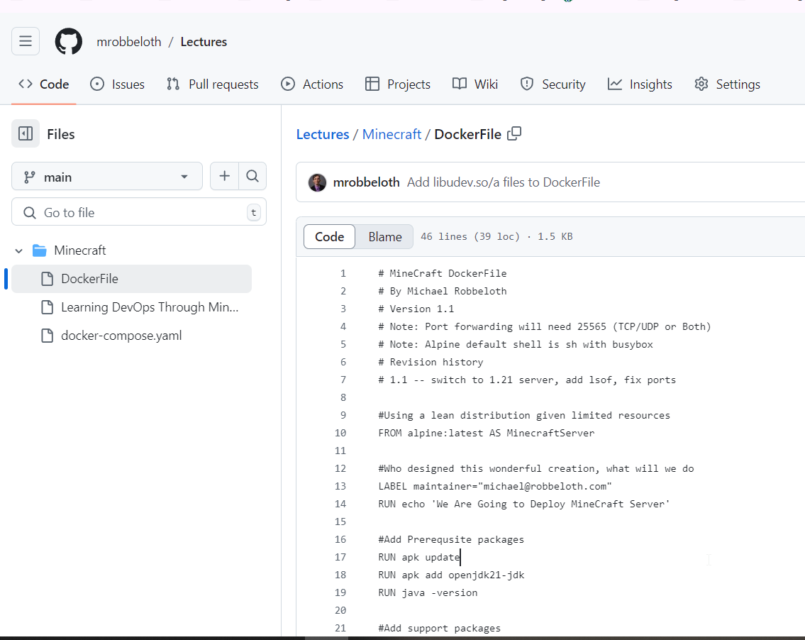

Slide 38
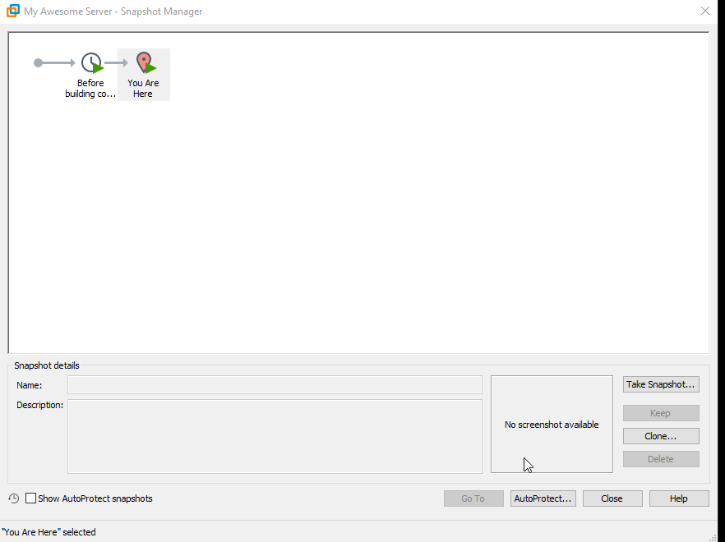
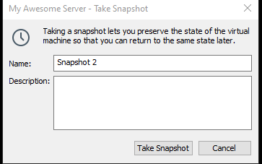
Sidebar: VMWare Pro snapshots
Before performing risky steps, take a snapshot
Right click on image in the Library and select Snapshot→Take a Snapshot
Give it a name, Click Take

Slide 39

Back to the VM 2/3
docker build –t minecraft .
Notes:
You want the raw text version not the html page
id <username> to confirm changes

Slide 40
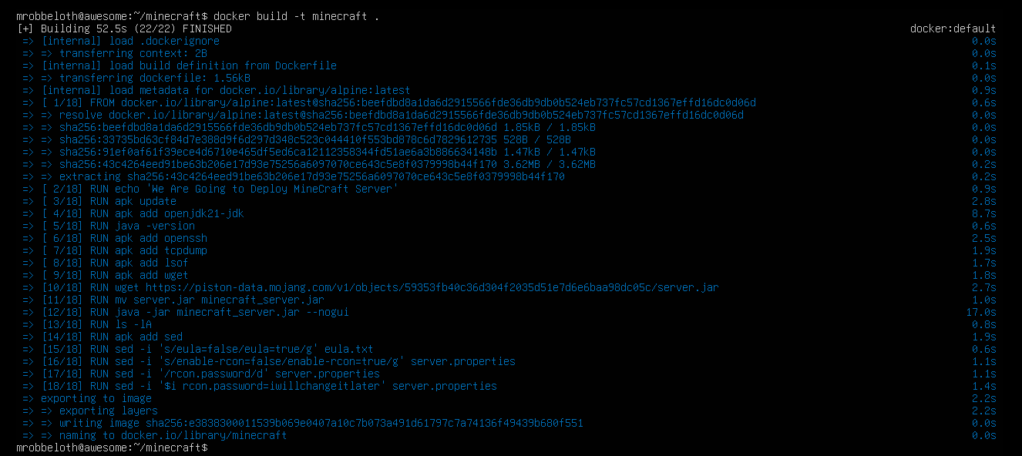

Slide 41
Back to the VM 3/3
docker run --name minecraft -p 25565:25565 -p 25575:25575 -d minecraft:latest
Notes:
-name is the name to refer to it in other docker commands
-p to export an exposed port container:host syntax
-d for detached
Which version to use, the latest

Slide 42
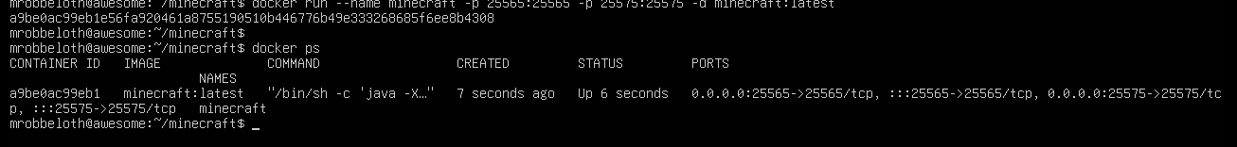
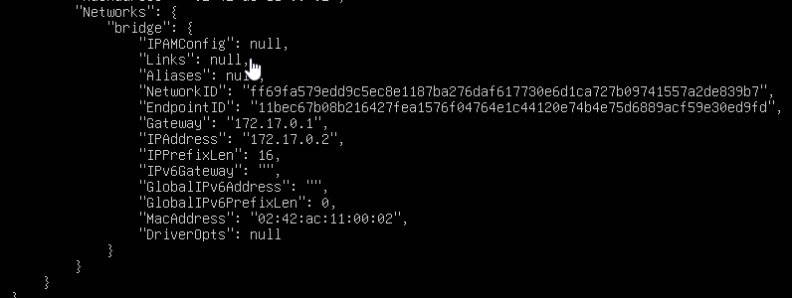
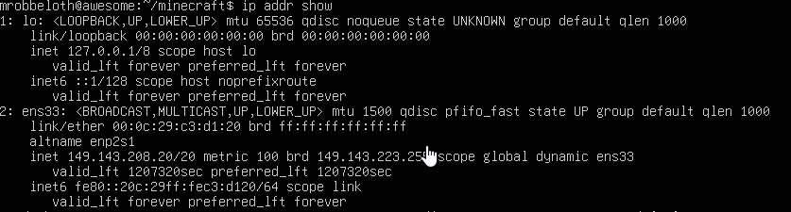
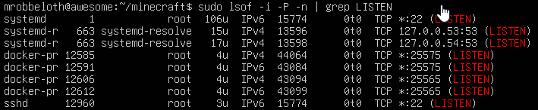
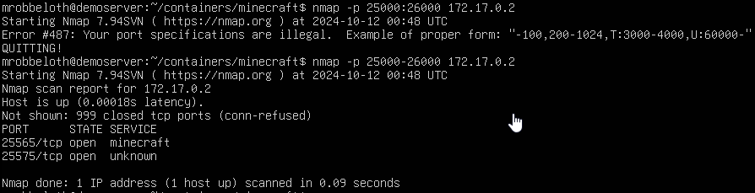

Notes:
Add a new server in the Minecraft Java client using the value for ens33(costs $30 to buy Minecraft and Bedrock editions)
Docker inspect to find ip address of server

Slide 43
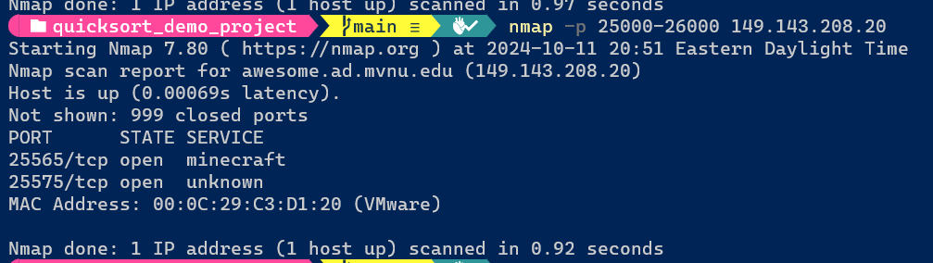

Slide 44
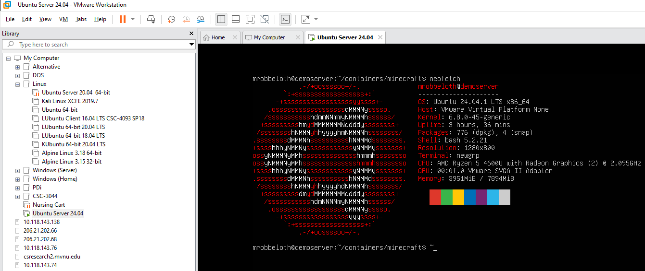
Notes:
Assuming the neofetch package is installed
Openvm-tools for copy paste should be installed by default

Slide 45
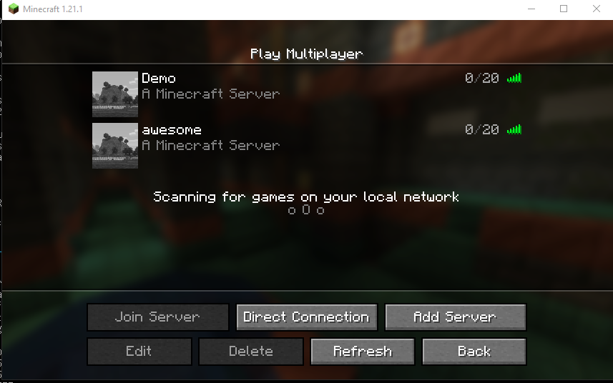
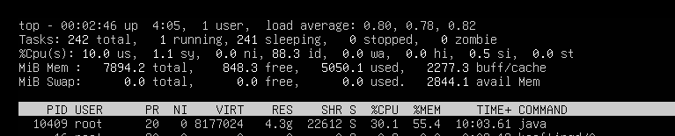
If it all goes right (Click Refresh after Edit)

Slide 46
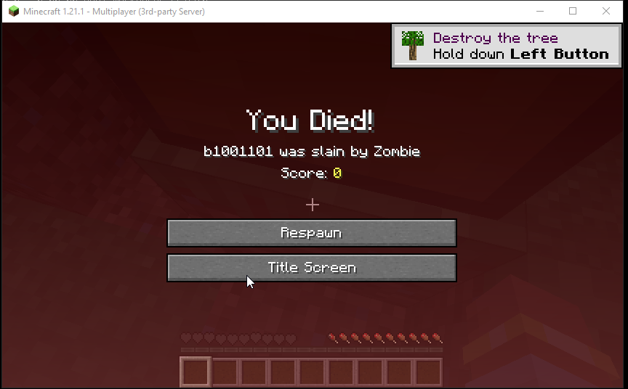
If it all goes right

Slide 47
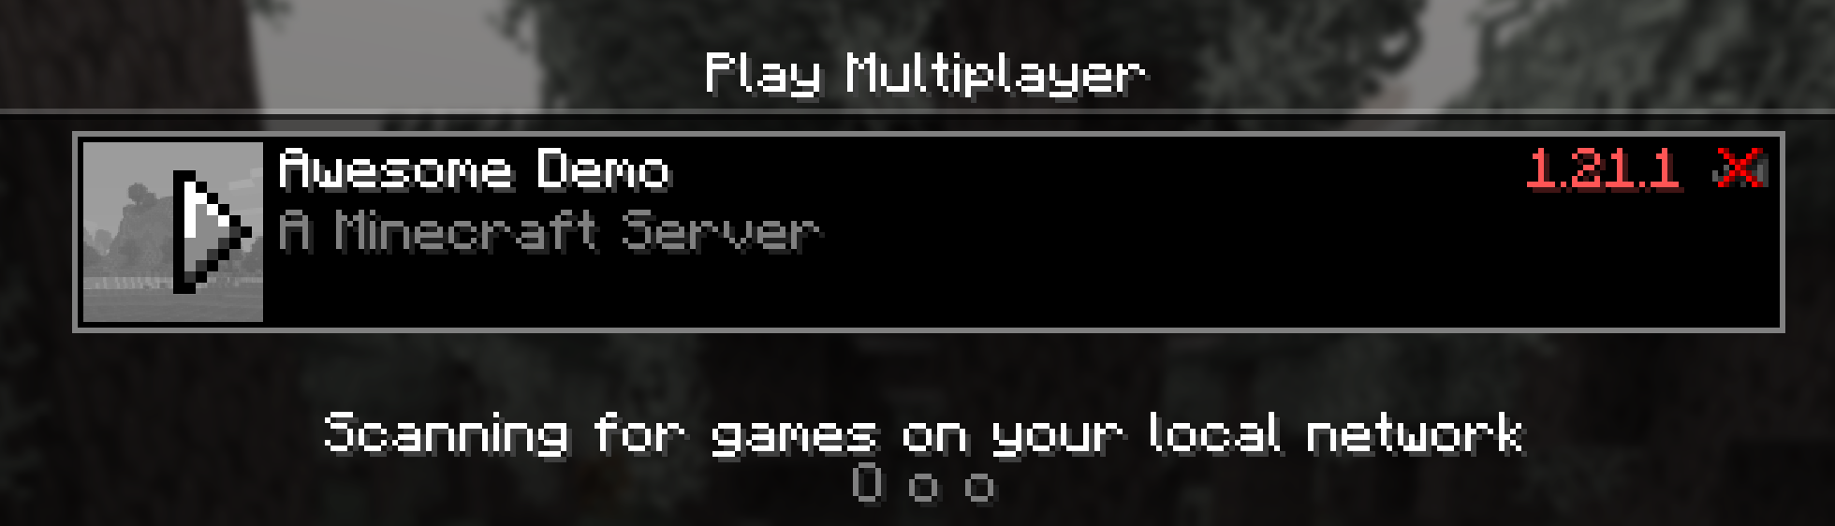
If it doesn’t all go right – version mismatch
Notes:
Update dockerfile, commit, push, pull on server, rebuild, and redeploy (remove old instance, start new one)

Slide 48
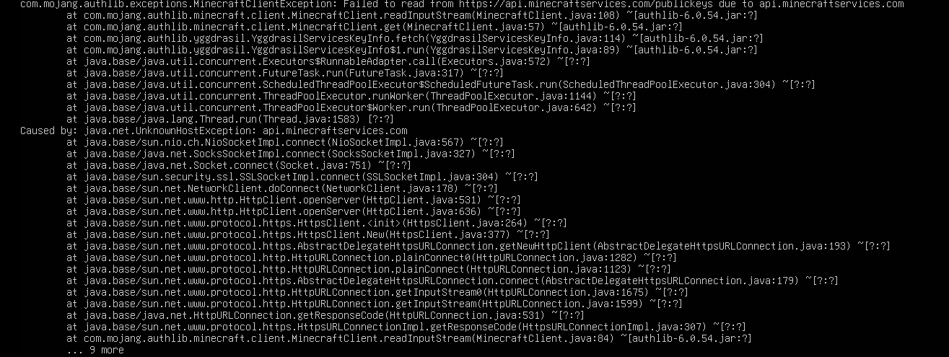
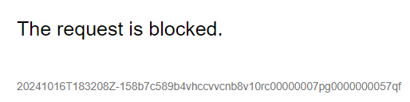
If it doesn’t all go right – firewall issue
Notes:
Trying to reach api.minecraftservices.com by itself results in blocked not from your network, but from destination, check w/ wireshark
Hence, curl on the api.minecraftservices.com/publickey
Subdomain won’t respond to a ping

Slide 49
Don’t forget to shut down
docker stop Minecraft
sudo shutdown now

Slide 50
Alternative is to use docker-compose
It’s meant for multi-container deployments, but we can learn the basics for launching one container
Production, staging, development, and testing workflows
Works w/ all stages of CI
Start/stop/Rebuild services
View status, stream output logs, run one-off commands
Use YAML configuration files
Notes:
You could use multiple Dockerfile and a bash scripts, but this is probably cleaner

Slide 51
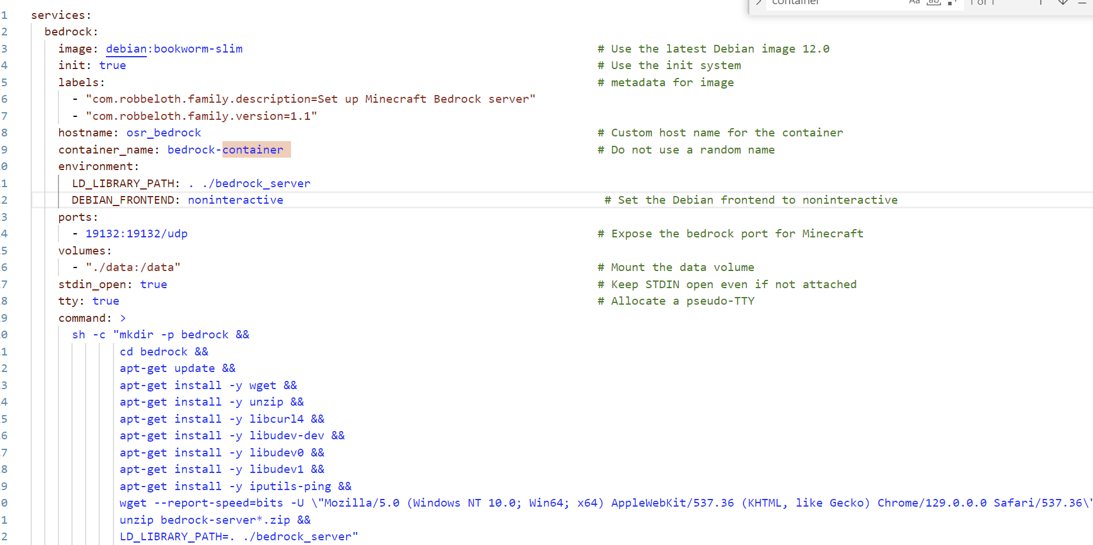
Docker Compose Code
wget --report-speed=bits -U \"Mozilla/5.0 (Windows NT 10.0; Win64; x64) AppleWebKit/537.36 (KHTML, like Gecko) Chrome/129.0.0.0 Safari/537.36\" \"https://www.minecraft.net/bedrockdedicatedserver/bin-linux/bedrock-server-1.21.50.10.zip\" &&
Notes:
https://docs.docker.com/reference/compose-file/services
Wget needs a user-agent string to work; the : before 04 needs to be changed to a dot.
Escape your quotes
Data directory is for plugins I think.

Slide 52
Commands
Start: docker compose up -d
Stop: docker compose down
Or docker compose down bedrock
Logs: docker compose logs
Services: docker compose ps
Notes:
The –d detaches everything

Slide 53
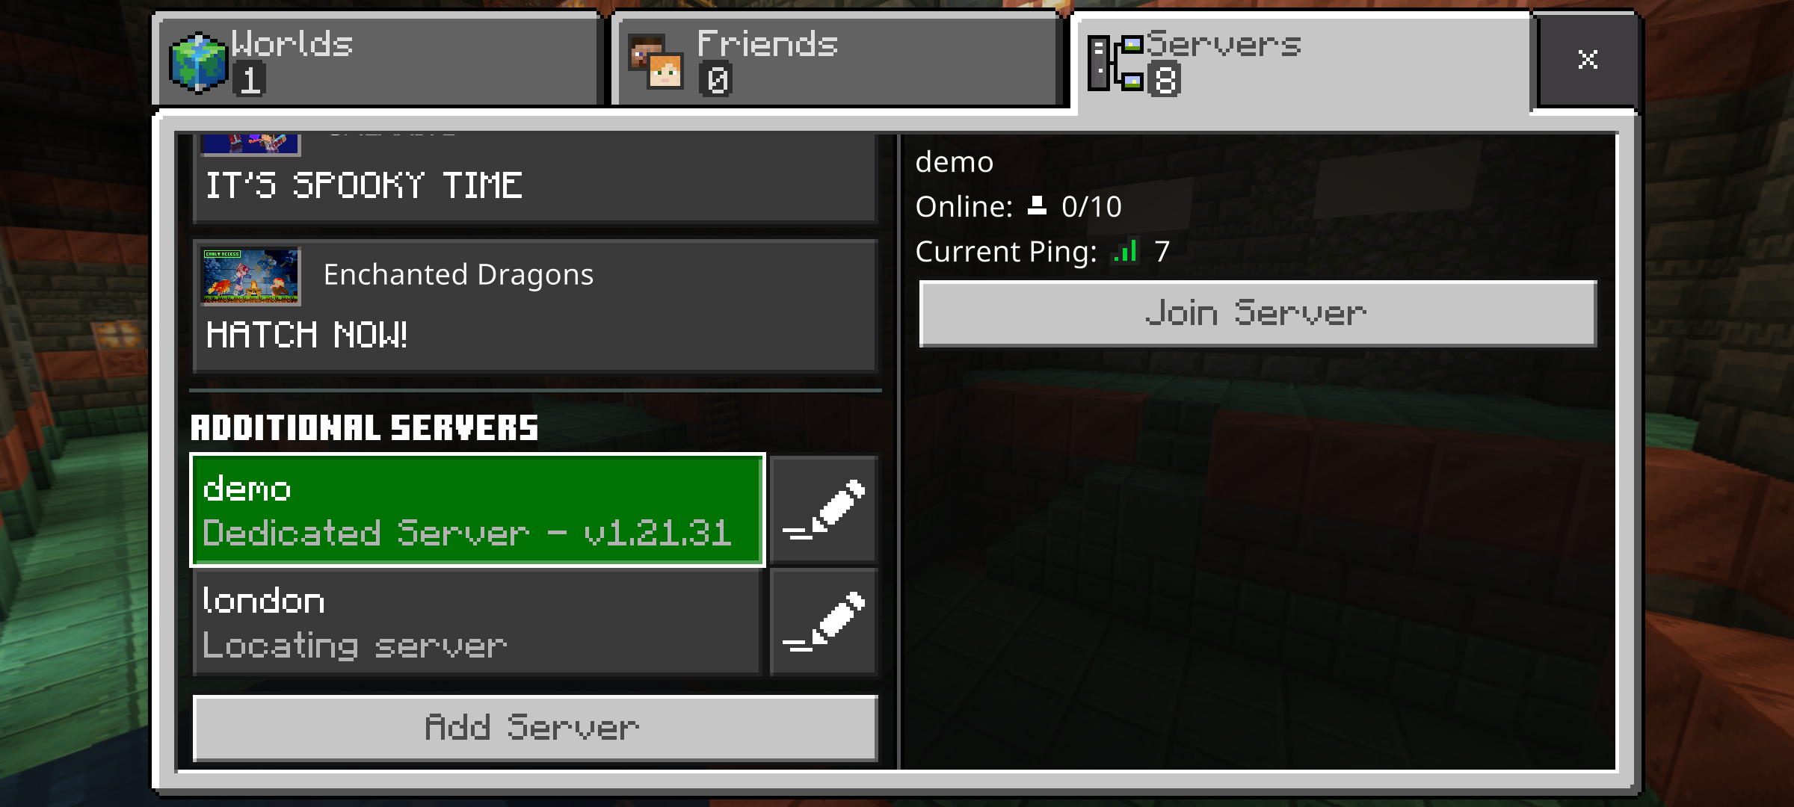
What about no ping data on Bedrock Server entry?
ip route add <docker container> via <docker gateway>
ip route add <docker gateway> via <vm ethernet/wifi host>
ip route add 172.17.0.2 via 172.17.0.1
ip route add 172.17.0.1 via 192.168.1.81
May also need sudo sysctl –w net.ipv4.ip_forward=1

Slide 54

Questions?
Thank you.

Slide 55
Backup/Extra Slides

